Slide 1
Migrating Your Data to the Cloud? Location Matters
Clay Jackson
Sr Sales Engineer

Slide 2
Are You Trying To Modernize Your IT Operations?
Are you…
under pressure from your business to lower IT infrastructure costs by migrating to the cloud?
trying to provide more speed and flexibility for access to data?
unsure about performance across all your platforms?
unsure about security across all your platforms?

Slide 3
You’re not alone!
Forrester – “over 50% of global enterprises in 2018 will rely on public cloud technologies”
Gartner – “business success is now tied to IT efficiency and flexibility”
IDC – “Availability, Performance and Security are the three main problems when it comes to cloud adoption”

Slide 4
Cloud 101

Slide 5
Cloud Essentials
On Demand
Broad Access
Resource Pooling
Elasticity
Measured Service

Slide 6
Cloud Service Models
Software as a Service (SaaS
Platform as a Service (PaaS)
Infrastructure as a Service (IaaS)

Slide 7
Cloud Deployment Models
Private
Community
Public
Hybrid

Slide 8
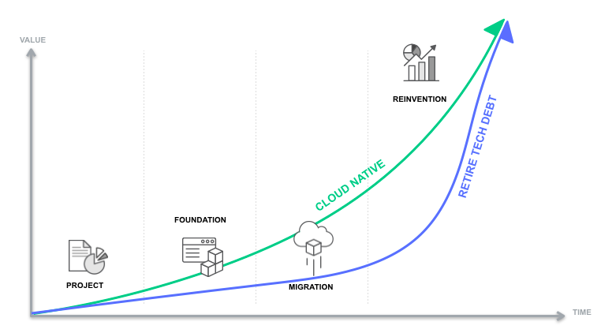
Stages of Cloud Adoption

Slide 9
Cloud Challenges

Slide 11
Security
Lack of Visibility
Theft/Breach
Lack of Control
Data in Transit
Compliance

Slide 12
Performance
Network Bandwidth
Network Latency
Disk Space
CPU Cycles
Memory

Slide 13
Governance/Control
Compliance
HIPAA
PCI
SOX
Control
Do you know where your data is?
Cost
Multiple Clouds
Access
Resources

Slide 14
Location Matters

Slide 15
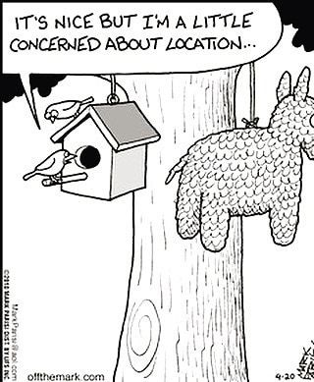
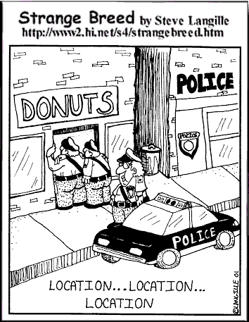
Just like Real Estate
Addresses challenges
May cause more challenges
One size does not fit all

Slide 16
Choosing your location wisely
Challenges specific to your project
Performance
Network Traffic
Compliance
HIPAA
PCI
SOX
Availabilty
Cost

Slide 17
Alternatives

Slide 18
Deployment and Service Models are the key
Sometimes Physical location can be important
Guards and Guns
Network traffic
Software as a Service will probably be remote

Slide 19
Public Cloud
Least Expensive
Least Secure
Easy Expansion and Contraction
Network traffic may be an issue
Bandwidth
Cost
Latency

Slide 20
Community Cloud
More secure than Public
Easy Expansion and Contraction
But there may be limits
May cost more
Data Sharing may be easier
Network traffic may be an issue
Bandwidth
Cost
Latency

Slide 21
Private Cloud
On Premise or Remote?
Most secure
Most costly
Expansion may be limited
Can be located near your customer
Faster access

Slide 22
Software as a Service
Almost always remote
No infrastructure costs
Less security
Less control
Is the data really yours?
Possible network traffic concerns

Slide 23
Platform as a Service
Almost always remote
Reduced infrastructure costs
Security can still be a concern
Control can still be a concern
Is the data really yours?
Possible network traffic concerns

Slide 24
Infrastructure as a Service
Can be remote or on premise
Same as today’s hosting
Still scalable
Most secure
Most control
More internal costs

Slide 25
Hybrid Cloud
All of the above!
Can be best of all worlds
Won’t completely eliminate on premise costs
Probably most resource intensive
Addresses security and network concerns
Puts the data where it’s needed

Slide 26
Tools

Slide 27
Replication – Synchronized Data in Multiple Places
Can mitigate migration issues
Downtime
Failback
Can mitigate security issues
Don’t replicate sensitive data
Can mitigate access issues
Keep data close to the customer
Access data across different versions of Oracle

Slide 28
Data Analysis Tools
Find sensitive data
Mask/Redact sensitive data
Develop Data Models
Generate and execute scripts

Slide 29
Performance Monitoring Tools
Identify performance bottlenecks
Test changes for effectivity
OnGoing monitoring

Slide 30
Benchmarking Tools
Capture Workloads
Test Workloads in new environments

Slide 31
Summary

Slide 32
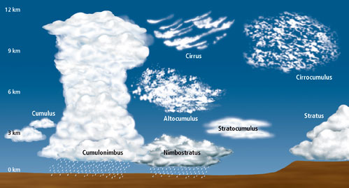
Cloud Migrations are a journey
Data placement (location) is important
Not all Clouds are equal
Processes and Tools can help

Slide 33
Q & A

